Slide 1
ASSIGNMENT
22-04-2025
Presented by S. Vinish

Slide 2
SAP Activate
SAP Activate is SAP’s innovation adoption framework used to implement, migrate, or upgrade SAP solutions like S/4HANA (on-premise or cloud).
It combines best practices, guided configurations, and an agile methodology to streamline project delivery.
Key Components of SAP Activate:
SAP Best Practices: Preconfigured business processes tailored to industries.
Guided Configuration: Step-by-step configuration assistance.
SAP Activate Methodology: Phased approach (Discover → Prepare → Explore → Realize → Deploy → Run).

Slide 3
Continued…
Business Scenarios Where SAP Activate is Applied:
New S/4HANA implementations (Greenfield)
System conversions from SAP ECC to S/4HANA (Brownfield)
Landscape transformation or selective data transitions
Cloud migrations (SAP S/4HANA Cloud or RISE with SAP)
Upgrading legacy SAP systems to newer releases.

Slide 4
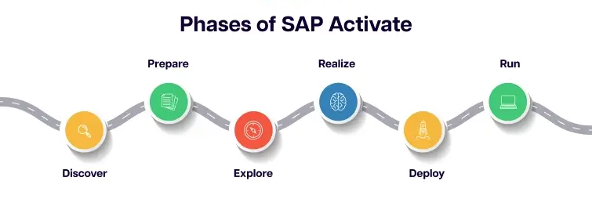

Slide 5
SAP Activate: Phases & Scenarios
1. Discover
Purpose: Understand the value of SAP solutions and assess readiness.
2. Prepare
Purpose: Plan the project, define governance, and set up environments.
3. Explore
Purpose: Perform Fit-to-Standard workshops and validate the solution against business needs.
4. Realize
Purpose: Configure, develop, and test the solution in iterative cycles.
5. Deploy
Purpose: Prepare for production cutover and go-live.
6. Run
Purpose: Operate, monitor, and optimize the live system.

Slide 6
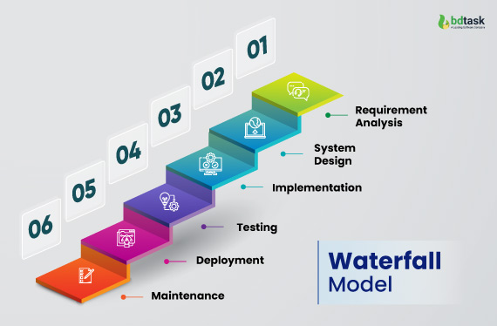
Waterfall Model
A linear and sequential project management approach where each phase must be completed before moving to the next.
Phases:
Requirement Analysis
System Design
Implementation
Testing
Deployment
Maintenance

Slide 7
Continued…
Advantages:
Simple and structured
Well-documented
Suitable for projects with clear, fixed requirements
Disadvantages:
Inflexible to changes
High risk and uncertainty
Late detection of issues (only in testing phase)

Slide 8
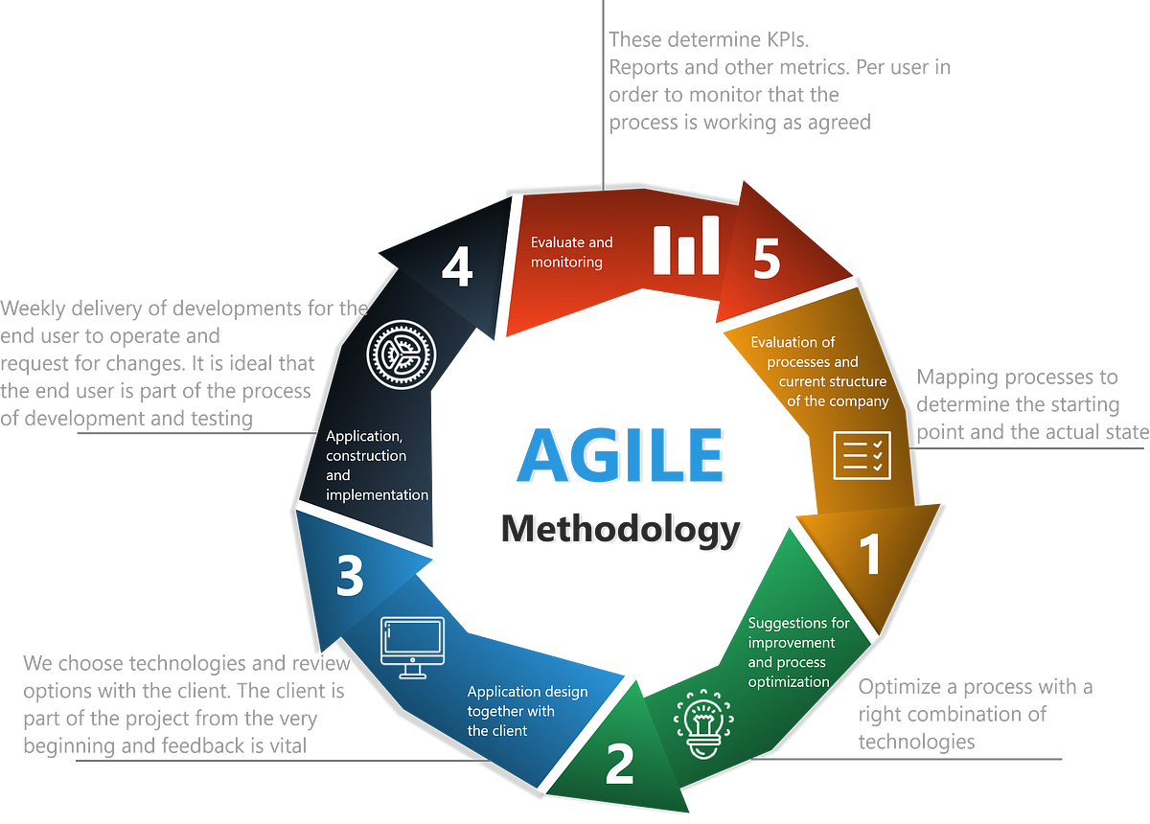
Agile
An iterative and incremental approach. Development is broken into small cycles called sprints, encouraging collaboration and adaptability.
Phases (Repeated in Sprints):
Plan
Design
Develop
Test
Review
Deploy

Slide 9
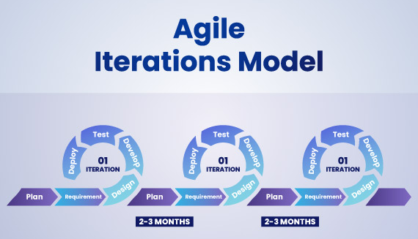
Continued…
Advantages:
High flexibility and adaptability
Continuous feedback and improvements
Faster delivery of working product
Disadvantages:
Requires frequent customer involvement
Less predictability
Can become chaotic without proper discipline

Slide 10
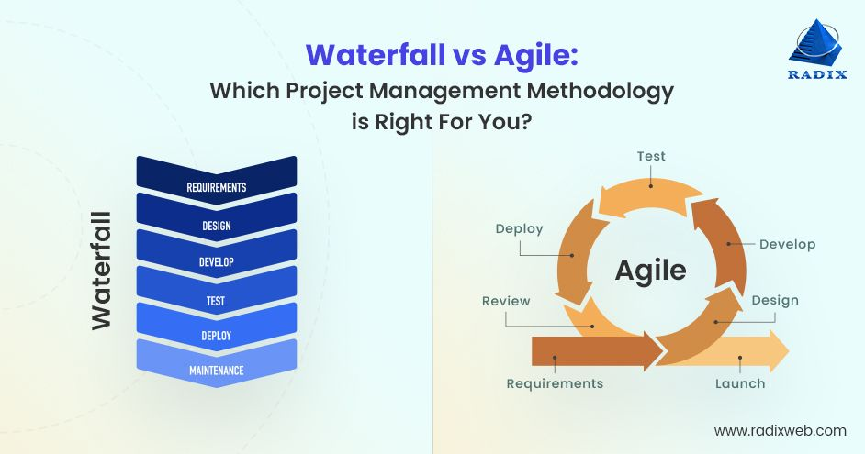
Aspect | Waterfall Model | Agile Model
Approach | Linear and sequential | Iterative and incremental
Flexibility | Rigid – changes are hard to incorporate later | Highly flexible – changes are welcomed anytime
Development Process | Entire project developed at once | Developed in small cycles (sprints)
Requirement Handling | Requirements are defined at the beginning | Requirements evolve with ongoing feedback
Customer Involvement | Limited to the start and end of the project | Continuous involvement throughout the project
Testing | Done after the build phase | Testing is done in every sprint
Risk Management | Higher risk due to late testing and integration | Lower risk due to early and continuous testing
Project Visibility | Low until the final phase | High – regular demos and reviews
Documentation | Heavy documentation | Lightweight documentation
Delivery Time | Product delivered at the end | Incremental delivery after each sprint
Suitability | Suitable for stable, well-defined projects | Best for dynamic, fast-changing environments

Slide 11
SAP-Recommended Methodology for On-Prem to Cloud Migration
The recommended methodology is SAP Activate using the RISE with SAP approach.
Steps Include:
Discover: Assess readiness using tools like SAP Readiness Check.
Prepare: Plan the landscape, define scope.
Explore: Fit-to-standard analysis to align processes with SAP best practices.
Realize: Build, configure, migrate data, test.
Deploy: Move to production.
Run: Operate and support in the cloud.

Slide 12
Migration & Conversion
Migration refers to the transfer of data or systems to a new environment, often a new installation such as SAP S/4HANA Cloud.
Conversion refers to transforming an existing SAP ECC system into an S/4HANA system while preserving its configuration and custom code.
Migration often involves a Greenfield approach, while conversion is a Brownfield process.

Slide 13
What Are the Tools Used for Migration and Conversion?
For System Conversion (ECC to S/4HANA):
SAP Readiness Check
A web-based analysis tool that evaluates the ECC system's readiness for S/4HANA conversion.
Maintenance Planner
A tool from the SAP Support Portal that helps plan and validate the system landscape before conversion.
Simplification Item List - A list of mandatory changes or removals in S/4HANA compared to ECC.
Software Update Manager (SUM) with DMO
SUM is a tool for system upgrades and conversions.
When used with DMO (Database Migration Option), it performs system conversion and database migration in a single step.
Pre-check Tools - Run in ECC system to identify critical functional or technical issues before starting conversion.
Custom Code Migration Tool - Assists in adapting custom ABAP code to the new S/4HANA architecture.
ABAP Test Cockpit (ATC) - A static code analysis tool for quality checks and custom code adaptations.

Slide 14
Continued…
For Data Migration (to S/4HANA):
SAP S/4HANA Migration Cockpit
LTMC (Legacy Transfer Migration Cockpit)
LTMOM (Migration Object Modeler)
SAP Data Services
SAP Landscape Transformation (SLT)
SAP Rapid Data Migration (RDM)

Slide 15
Difference Between Migration and Conversion
Aspect | Migration | Conversion
Definition | Moving data from one system to another (e.g., ECC to S/4HANA Cloud). | Transforming an existing ECC system into an S/4HANA system.
Type | Usually Greenfield (new implementation) or selective data migration. | Brownfield (reuse existing system/data).
Tool Involvement | Data migration tools (Migration Cockpit, SLT, Data Services). | Technical tools (SUM with DMO, ATC, Readiness Check).
Data | Can be partial or full data migration. | All data including configuration and customizations is converted.
Customization | Requires reconfiguration and process redesign. | Retains most of the existing configurations and custom code (with adjustments).
Use Case | Legacy to S/4HANA Cloud or Greenfield S/4HANA on-prem. | ECC to S/4HANA system with same SID, data, and custom logic.

Slide 16
Thank You

